Slide 1
Principles of Electronic Media Administration
AFM Officer Training 2024

Slide 2
Agenda
Contract Theory
Agreement Categories
Locally-Administered Agreements
Case Study
The Checklist
Q & A

Slide 3

EMSD Contract Theory

Slide 4
The Universe
Notes:
All recorded work performed domestically falls into this box. Each cell in the grid represents a recording project or session. Different types of work can be thought of as being divided into the separate columns. The ultimate goal is to achieve 100% coverage of all of the work in the box (this is not realistic, of course). The Union must strive to get as much work in the box under contract as possible. That is “union density” of projects in recording. The dotted line at the top implies that it is not possible to actually know how large the box is.

Slide 5
Self-Produced Work / Joint Ventures
Notes:
Not all recordings have an Employer. A large (technically, again, unknowable) percentage of work is self-produced and self-recorded. Recordings without an Employer are exempt from standard signatory requirements. The AFM and its Locals can protect this work under a Joint Venture Agreement. Everything in grey is a joint venture, which means everything remaining in white represents a work-for-hire situation with a standard Employer or Producer.

Slide 6
Promulgated Agreements
Notes:
Not all work falls under our main collective bargaining agreements either. Remember, all recorded work falls under some kind of coverage, so sometimes the AFM must promulgate an agreement to cover something. All of this work falls under a special letter of agreement that is usually signed with the Federation on a case-by-case basis. Everything that remains in white on this grid is a project that theoretically falls under a CBA.

Slide 7
CBA Compliance
Notes:
All CBAs require session reports to be filed with the Local of jurisdiction along with wage checks and benefits, usually within 15 business days. When work is filed on time and correctly, then the Producer is in compliance with the CBA. That work is shown in green. With compliant work, a Local has responsibilities: confirm that paychecks are accurate and disburse them to musicians, collect work dues, make sure benefit checks are transmitted to the appropriate funds, send copies of the paperwork to a variety of destinations, do data entry, organize the physical paperwork. All of this will be discussed in “The Checklist” at the end of the presentation. Note that this is not an insignificant amount of work for contracts that are correct to begin with.

Slide 8
Enforcement (“Compliance Gap”)
Notes:
When covered recordings are filed incorrectly, the CBA needs to be enforced to make the terms right. Any time work is either (1) late, (2) incorrect, or (3) missing, the Union is required to take action. Everything in the purple area requires additional Union work to have the recording be filed correctly. The Union is obligated to take every necessary step to fill this “compliance gap.” Filling the compliance gap is taxing on the Union’s finite resources (staff and time), so our administrative goals must include taking steps to shrink this gap before it’s created in the first place. We achieve this through member and employer education.

Slide 9
Expansion and Organizing
Notes:
The gold area is work produced by an Employer that is not presently signatory. It’s non-AFM. I refer to this area as the “Expansion Area,” and projects that fall here require an Organizing effort to bring them under contract and an Education effort to bring them into Compliance.

Slide 10
Summary of Contract Theory
EMSD administration requires staff time and resources, even when the work is Compliant.
Every other category in the chart requires the same amount of work plus additional administrative work to make the project Compliant.
The administrative goals of EMSD are, therefore:
Cover as much of the chart as possible under contract (shrink the “Expansion Area,” cover Joint Ventures). This is primarily Organizing.
Educate members and employers, to shrink the Compliance Gap.
Streamline the administration of Compliant contracts so that straightforward processing diminishes fewer Union resources.

Slide 11
Expectations of Local EMSD Abilities
Maintaining relationships with musicians and employers working in their jurisdiction. Be able to provide current rates (available on AFM.org; national rates are public-facing, not in the Member section).
Determining the appropriate agreement to use for straightforward recording work. (Federation will assist when agreements are not straightforward or need to be promulgated.)
Ability to confirm that payments are correct under a given agreement and initiate claims (Enforcement) if they are not.
Work with Organizing when focusing on Joint Ventures or the Expansion Area.

Slide 12
Agreement Categories

Slide 13
Sound Recordings
Capture: Audio recordings of individual tracks, usually but not exclusively with vocals/lyrics. Not generally on camera.
Exhibition: Intended to be released as individual tracks for commercial sale (physical product via albums, digital downloads, streaming on DSPs).
Signatories: Record labels, Producer who owns the copyright to the sound recording.

Slide 14
Films/Motion Pictures
Capture: Usually also involves individual tracks (here called “cues”) intended to be synched to a separately captured visual piece. Usually, the visual has been filmed first. Sometimes, a musician may “sideline” if they appear in the visual piece, which pays separately.
Exhibition: Audio score is synched to a motion picture, which is released either in cinemas, on television, or on streaming platforms.
Signatories: The Producer of the motion picture.

Slide 15
Commercial Announcements
Capture: Almost identical to film, audio scoring synched to a separately filmed visual. On-camera musicians may also be “sidelining.”
Exhibition: However, in this case, the visual is an advertisement and the usage is to promote a product, event, company, etc.
Signatories: Primarily the advertising agency, though occasionally the product/client.

Slide 16
Live Broadcasts
Capture: Inherently audiovisual in nature. Programming is performance-based and the musicians are performing live, simultaneous to the visual capture.
Exhibition: Television or New Media platforms. The programming is not narrative-based: variety shows, game shows, news, etc. (Caveat: soap opera scoring is covered here for historical purposes, as they were once scored live.)
Signatories: The Producer of the program, more often a third-party producer than the network itself.

Slide 17
Every Agreement Falls into One of These Categories
Sound Recordings | Films | Commercials | Live Broadcasts
SRLA | Theatrical and Television Film | Commercial Announcements | Videotape (Network TV)
Audio Demos | Industrial Films | Made and Played Local Commercials | Basic Cable
Limited Pressings | Indie / Festival Films |  | Pay Cable
Single Song Overdubs | Video Games |  | Public TV
Theme Parks* | Theme Parks* |  | Radio
Music Videos |  |  | Visual Archivals
 |  |  | Internet Streaming Agreements
 |  |  | Local Media (non-Internet)

Slide 18
Music Preparation
Music preparation covers the production of sheet music so an ensemble can perform a musical piece.
Composition is not covered under AFM agreements, but four classifications of music preparation work are: arranging, orchestrating, copying, and the work of librarians.
Music prep is generally paid by output, rather than by time. Orchestration and copying services are paid by the page. Arrangers may charge their own fees (no less than orchestration scale) because the service is highly specialized.
Music prep is paid once per medium and can often be a big budget item.

Slide 19
Locally-Administered Agreements

Slide 20
These Agreements Do Not Require Federation Countersignature
Joint Ventures
Demonstration Recordings
Limited Pressings
Single Song Overdubs
Made and Played Commercial Announcements
Local Broadcast Media (TV and Radio without Streaming)
Short-Term Internet Streaming under Local Addendum

Slide 21
Case Study

Slide 22
Concert Capture
A major recording artist is performing a series of concerts with a Local orchestra in your jurisdiction. The orchestra is not an IMA signatory.
The artist intends to record every concert in the series.
The artist does not know how the content will be utilized but wants a summary of all possible costs / an expected budget so they can make an informed decision about exhibition.
Where do you even start?

Slide 23
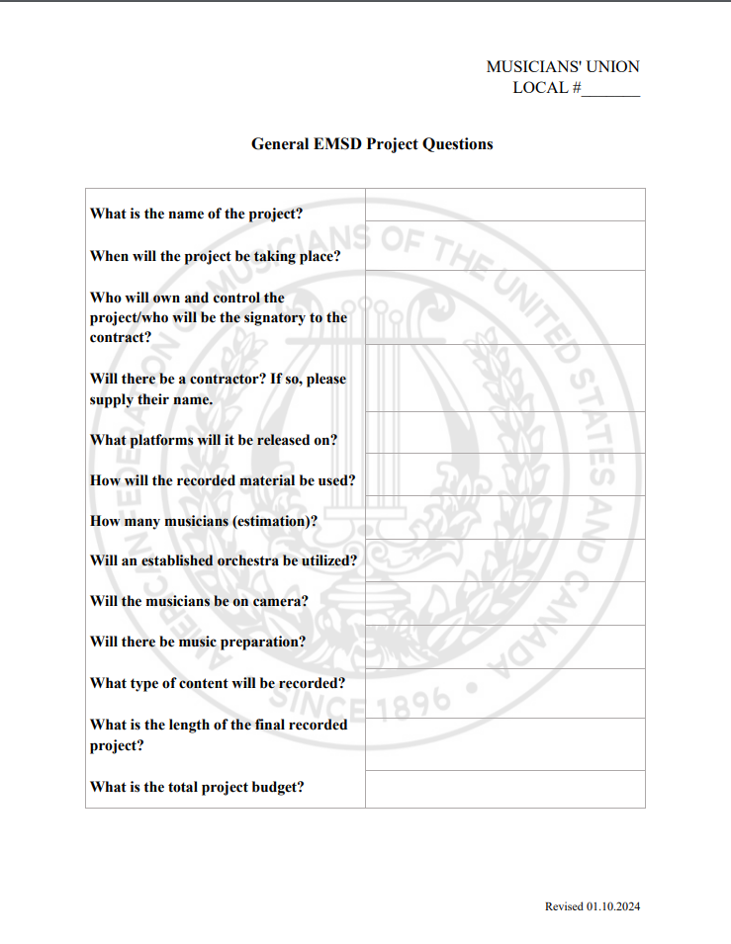

Slide 24
Things to Keep In Mind
Use Theatrical Motion Picture if there is even the slightest possibility that the material will be released in cinemas. Payment under this agreement becomes mandatory upon such a release.
Any commercial release of the audio would be a Location Recording under a Sound Recording Agreement. SRLA has coverage for “Concert DVDs.”
If they are also filming rehearsals, they might be looking at a “making of” documentary, which in itself could be a second film.
Straight release of concert footage to streaming without soundtrack release or cinematic release should utilize Videotape.

Slide 25
The Checklist

Slide 26
The Checklist
B-3 | Made and Played Commercials
B-4 | Sound Recordings, Records
B-5 | Audio Demos
B-6 | Commercial Announcements
B-7 | Film / Miscellaneous
B-8 | Live Television
B-9 | Limited Pressings
B-10 | Radio
B-11 | Symphonic AV Agreement (old)
B-12 | Symphonic Non-Commercial (old)
B-16 | Symphonic IMA
B-17 | Single Song Overdubs
None | Music Prep, Joint Ventures
Confirm that there was an appropriate signatory to the appropriate agreement.
Confirm that the wages and benefits are paid correctly.
Disburse wage checks to the musicians and collect work dues.
Process the pension contributions.
Retain a permanent copy in the Local’s records, including any data entry the Local performs.
Upload a copy to AFM EMSD via the AFM.org portal.
Remit copies to other relevant parties: Producer, Leader (but not Sidepersons), Residual Funds, etc.
Remit the Federation portion of work dues monthly.

Slide 27
Q & A
John K. Painting
Director, EMSD
jpainting@afm.org
(917) 229-0213

